Slide 1
Digital Portfolio
STUDENT NAME:isham G
REGISTER NO AND NMID: asunm1112401111058019
DEPARTMENT: computer science
COLLEGE: L.N.government college,madras University.

Slide 2
PROJECT TITLE
DIGITAL PORTFOLIO using front end web development

Slide 3


AGENDA
Problem Statement
Project Overview
End Users
Tools and Technologies
Portfolio design and Layout
Features and Functionality
Results and Screenshots
Conclusion
Github Link
3/21/2024 Annual Review

Slide 4

PROBLEM STATEMENT
1. This portfolio introduces Chandru A, a passionate student learning web development.2. It provides sections for About Me, Projects, and Contact, making navigation simple.3. A visually appealing hero section highlights his name and profession with modern colors.4. The About section includes a professional photo and a brief introduction.5. The Projects section displays work samples to showcase technical skills.6. A contact form and footer make it easy for teachers, peers, or recruiters to connect.

Slide 5

PROJECT OVERVIEW
1. The portfolio is a personal branding website for student developer Chandru A.2. It highlights his skills, projects, and academic interests in web development.3. Built with HTML, CSS, and JavaScript, it ensures responsiveness and smooth interaction.4. The design uses a modern gradient theme to create visual appeal and professionalism.5. It includes About, Projects, and Contact sections for easy navigation.6. The portfolio acts as both a resume showcase and a professional digital identity.

Slide 6

WHO ARE THE END USERS?
1. Teachers and mentors who want to track Chandru A’s learning progress.2. Recruiters and companies seeking fresh talent in web development.3. Peers and classmates who may collaborate on projects or learning activities.4. Hackathon organizers or tech clubs looking for passionate participants.5. Friends and family who want to see his growth and achievements.6. General audiences online exploring student portfolios for inspiration.

Slide 7

TOOLS AND TECHNIQUES
1. HTML5 is used to structure the web pages and sections of the portfolio.2. CSS3 provides styling, gradient themes, layouts, and responsive design.3. JavaScript (ES6) adds interactivity like mobile navigation and form validation.4. Flexbox and Grid techniques manage layouts across devices.5. A mobile-first approach ensures smooth viewing on smartphones and desktops.6. The portfolio applies clean code and user-focused design principles.

Slide 8
POTFOLIO DESIGN AND LAYOUT
1. The portfolio follows a modern, minimal, and professional design.2. It is divided into Home, About, Projects, and Contact sections.3. The hero section highlights Chandru A with bold text and gradient design.4. The About section includes a profile photo and introduction text.5. The Projects section uses a grid layout for project cards.6. The Contact section and footer ensure easy communication and closure.
8

Slide 9
FEATURES AND FUNCTIONALITY
1. A responsive navigation bar adapts to both desktop and mobile screens.2. The hero section introduces Chandru A with an eye-catching design.3. The Projects section uses interactive cards with hover effects.4. The About section combines a profile image with descriptive text.5. A contact form with validation ensures proper message submission.6. The footer gives copyright info and space for future social media links.

Slide 10
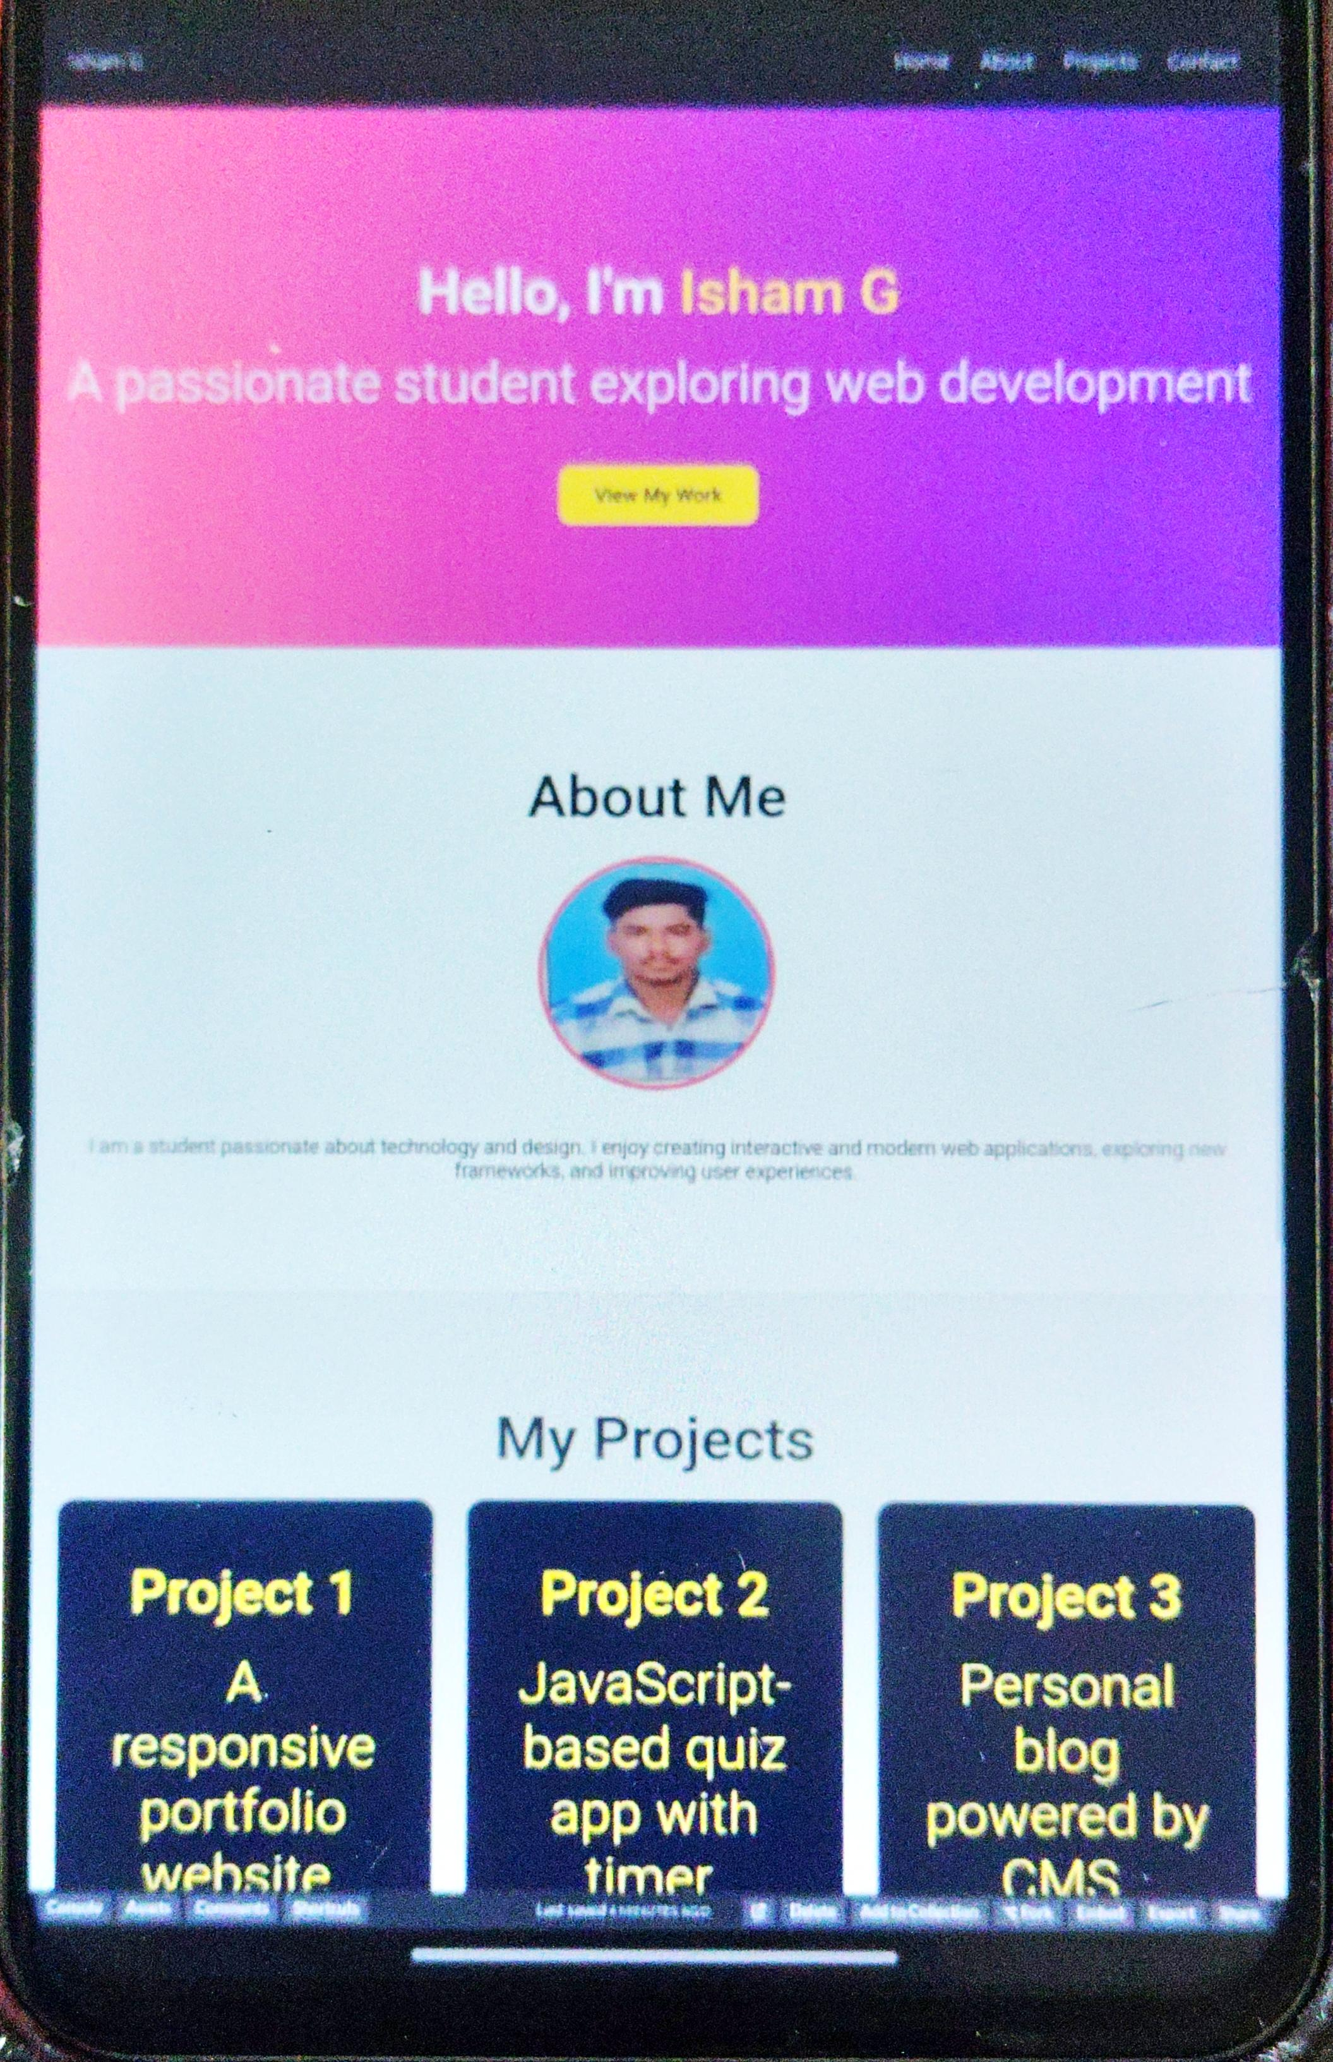
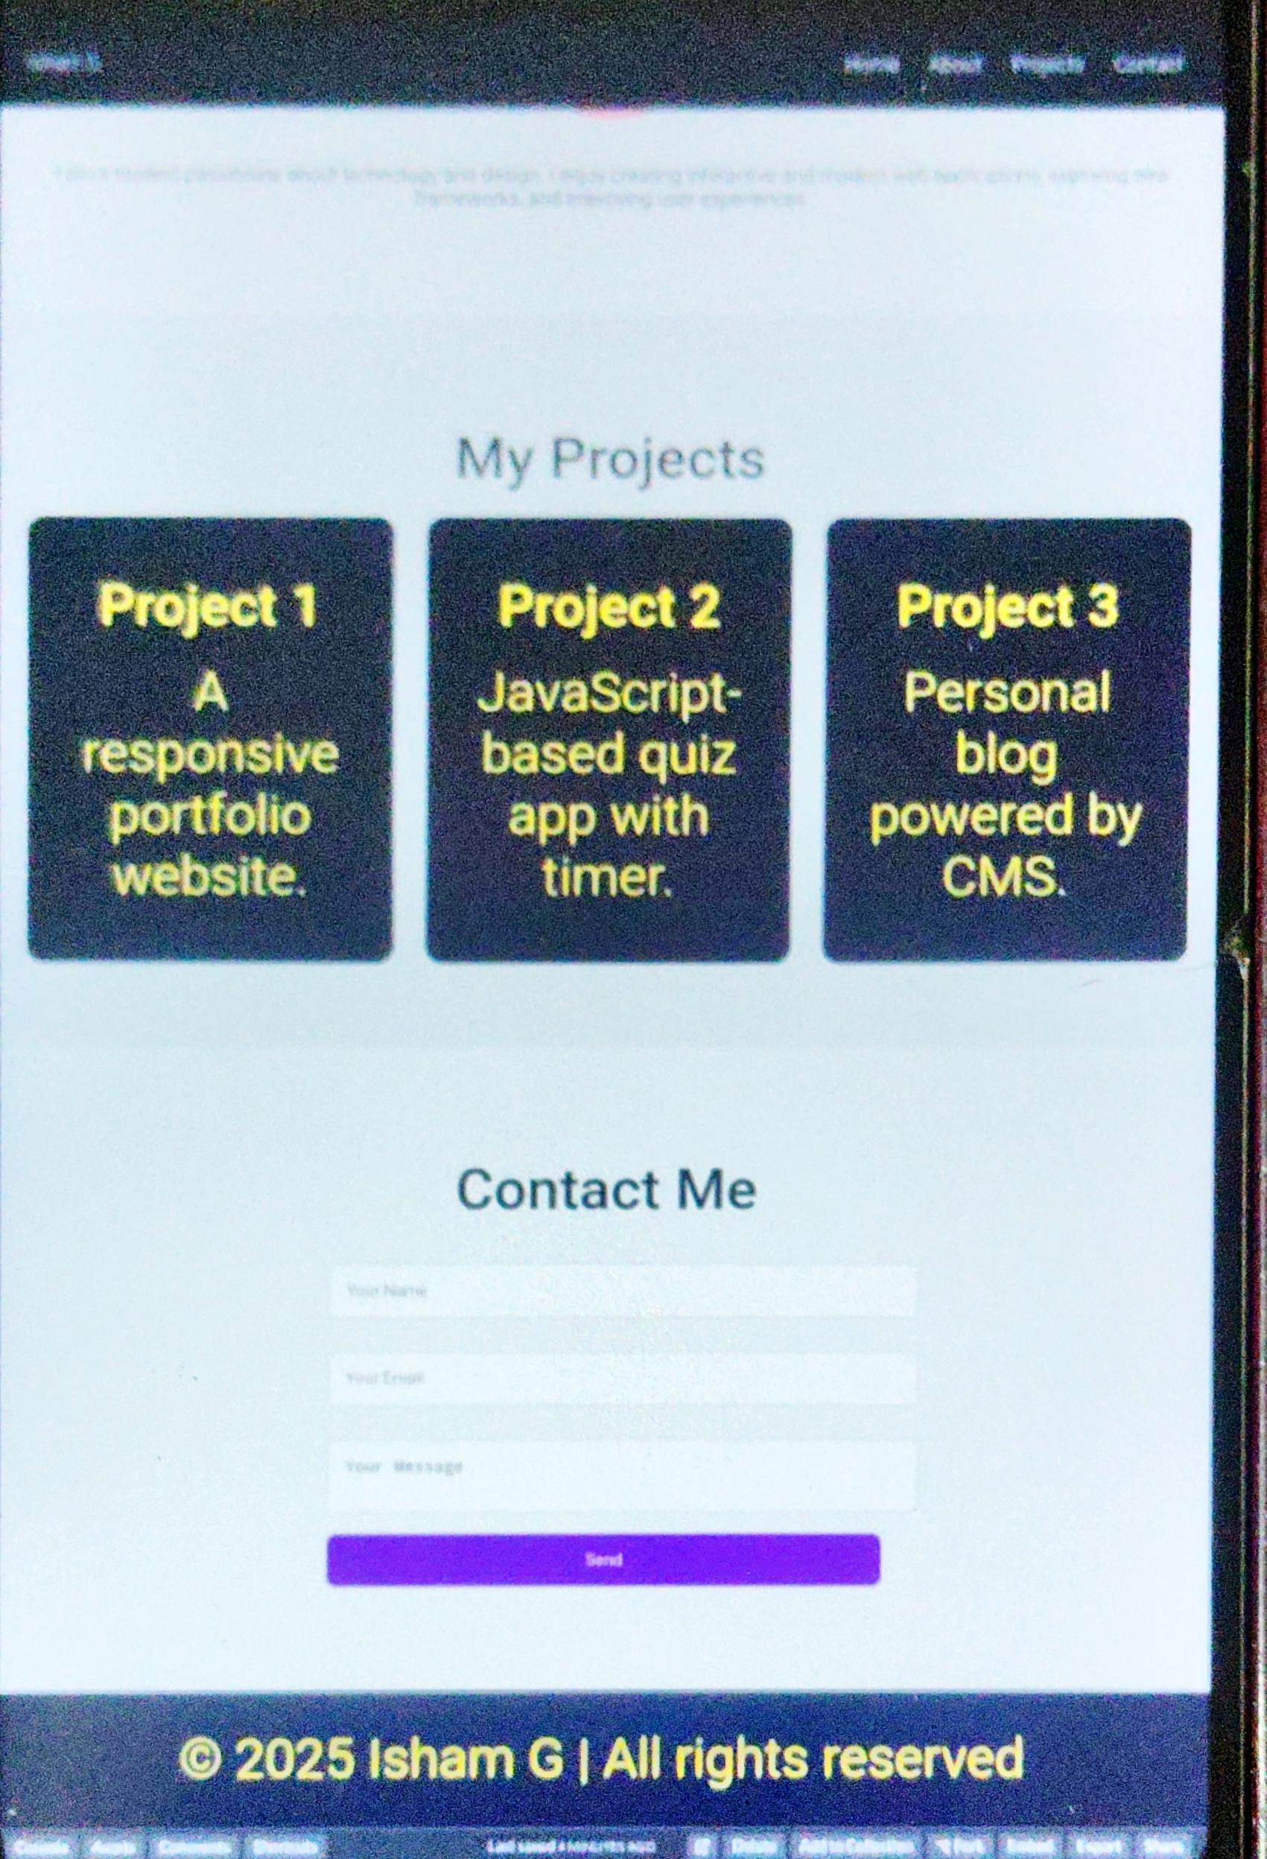

RESULTS AND SCREENSHOTS
3/21/2024 Annual Review
10

Slide 11
CONCLUSION
1. The portfolio presents Chandru A’s skills, projects, and personal journey effectively.2. It uses modern design and responsive layouts for accessibility on all devices.3. HTML, CSS, and JavaScript demonstrate technical proficiency.4. Interactive elements like menu toggle and contact form improve engagement.5. Acts as a digital resume and personal branding tool for opportunities.6. Combines creativity and professionalism, leaving a positive impression on visitors.
11

Slide 12
GitHub link
https://ishamg55-debug.github.io/TNSDC-FWD-DP/

